Slide 1
HOW TECHNOLOGY HAS CHANGED MARKETS
Bitcoin and Cryptocurrency
DAY 1/2

Slide 3
What is an Arbitrageur?
In nearly all instances, the cause of arbitrage is on the basis of private information known by the arbitrageur, and ex-post facto (having executed the trades) can boast of the discovery of those inefficiencies, maybe 10-years later.
For example, a “would be” arbitrageur may use information about an impending takeover to buy up a company's stock and profit from the subsequent price appreciation. Which is known as “merger arbitrage” and is not in any sense a true “Arbitrage”.
Arbitrage generally is the concept of purchasing an identical financial vehicle at a lower price than all other market participants.
Notes:
Here is a short background of my involvement as a market-maker and arbitrageur for the last decade or so.

Slide 4
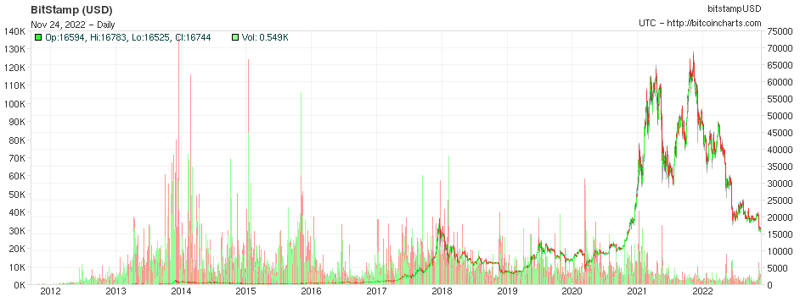
Notes:
In 2014-2015 I coded and deployed a Bitcoin miner and mined about two coins in roughly two months. This of course, was when bitcoin was valued at roughly $350/BTC

Slide 5
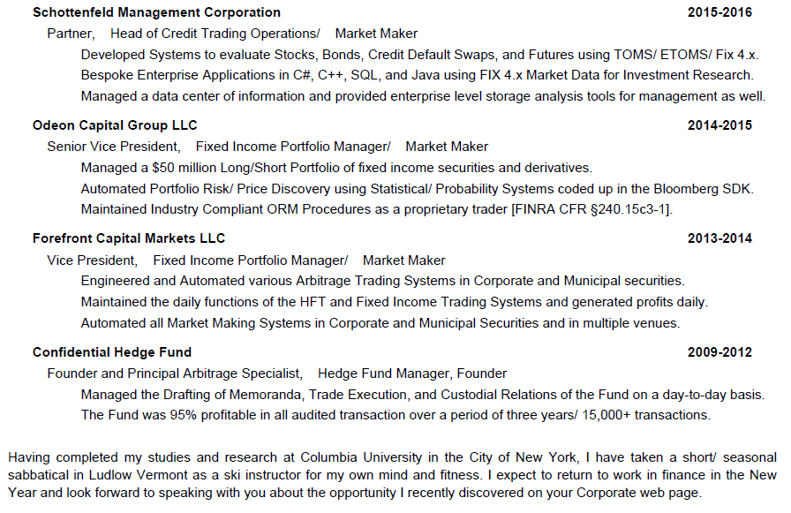
Notes:
Here is a short background of my involvement as a market-maker and arbitrageur for the last decade or so.

Slide 6
What is an Arbitrageur?
An arbitrageur is a type of investor who attempts to profit from market inefficiencies.
These inefficiencies can relate to any aspect of the markets, whether it is price, dividends, or regulation. The most common form of arbitrage is price.
Arbitrageurs exploit price inefficiencies by making simultaneous trades that offset each other to capture risk-free profits.
An arbitrageur would, for example, seek out price discrepancies between stocks listed on more than one exchange by buying undervalued shares on one exchange and selling short an equal number overvalued shares on another exchange.
- The goal is to capture risk-free profits as the prices on the two exchanges converge, and in most cases an arbitrageur, upon discovery, will cause those prices to disappear (momentarily) and re-calibrate to what most people understand as the efficient market hypothesis.
Notes:
Here is a short background of my involvement as a market-maker and arbitrageur for the last decade or so.

Slide 7
What is an Arbitrageur?
In nearly all instances, the cause of arbitrage is on the basis of private information known by the arbitrageur, and ex-post facto (having executed the trades) can boast of the discovery of those inefficiencies, maybe 10-years later.
For example, a “would be” arbitrageur may use information about an impending takeover to buy up a company's stock and profit from the subsequent price appreciation. Which is known as “merger arbitrage” and is not in any sense a true “Arbitrage”.
Arbitrage generally is the concept of purchasing an identical financial vehicle at a lower price than all other market participants.
Notes:
Here is a short background of my involvement as a market-maker and arbitrageur for the last decade or so.

Slide 8
What is an Arbitrageur?
Arbitrage generally is the concept of purchasing an identical financial vehicle at a lower price than all other market participants.
A true arbitrageur is also aware of the demand for the financial vehicles at a higher price at the time he/ she is purchasing the instrument, whether it be a stock, bond, crypto contract, a swap or an actual vehicle – there must be 100% certainty of a cash (liquid) buyer at the instant he/ she is buying the vehicle.
Notes:
Here is a short background of my involvement as a market-maker and arbitrageur for the last decade or so.

Slide 9
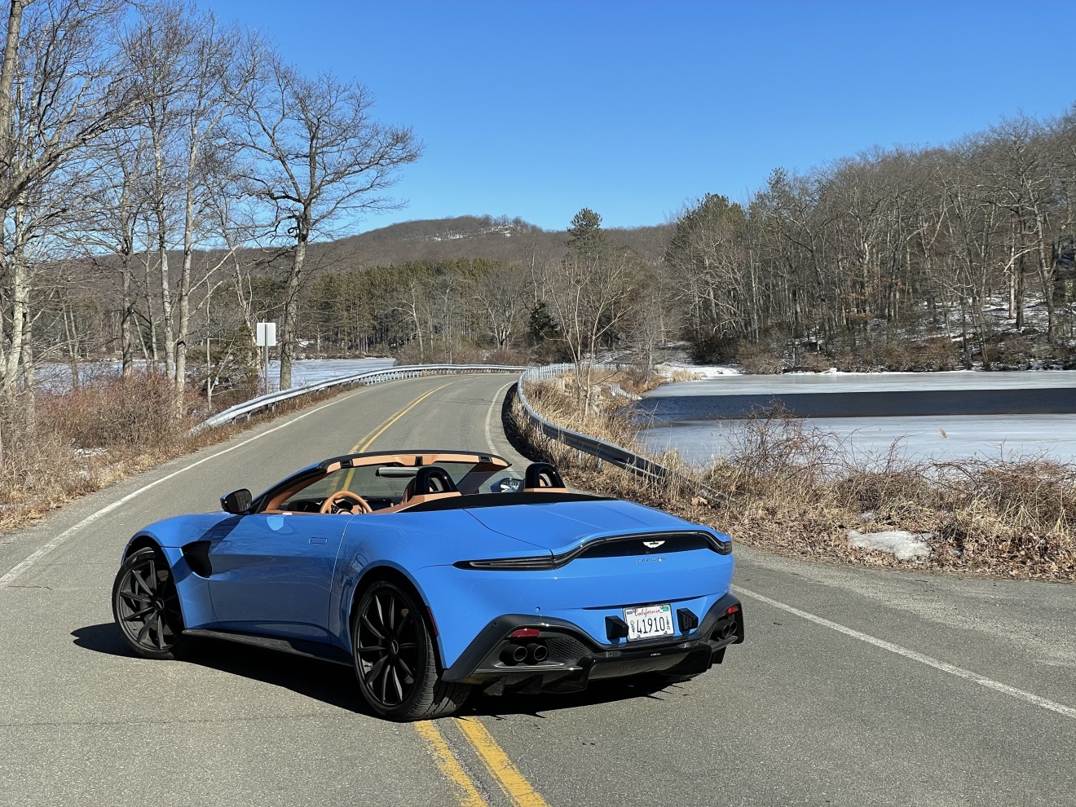
What is an Arbitrageur?
EXAMPLE: The James Bond of Car Dealerships.
Notes:
Here is a short background of my involvement as a market-maker and arbitrageur for the last decade or so.

Slide 10
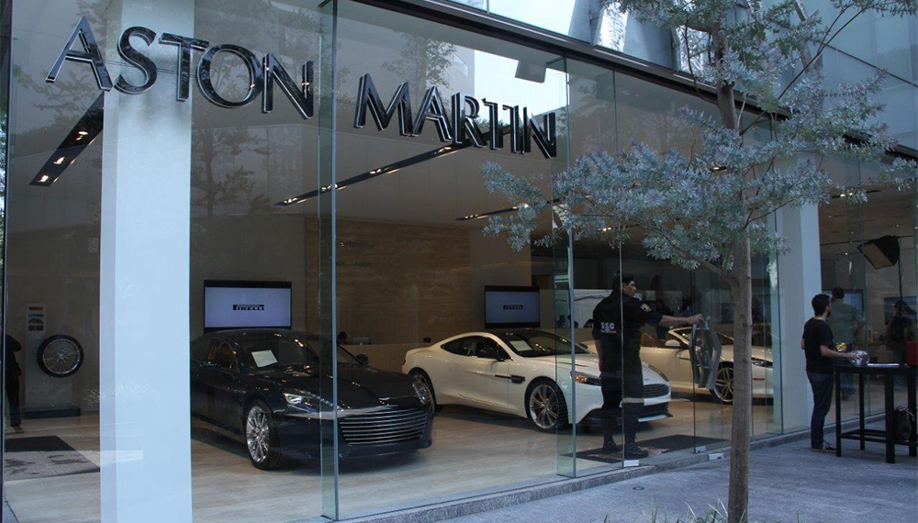
What Is an Arbitrageur?
What Is an Arbitrageur?
EXAMPLE: The James Bond of Car Dealerships
- Not a Financial Vehicle, but still a vehicle of Arbitrage.
Notes:
I will provide an example, in layman’s terms of how arbitrage exists – in a physical delivery market, rather an exchange.

Slide 11
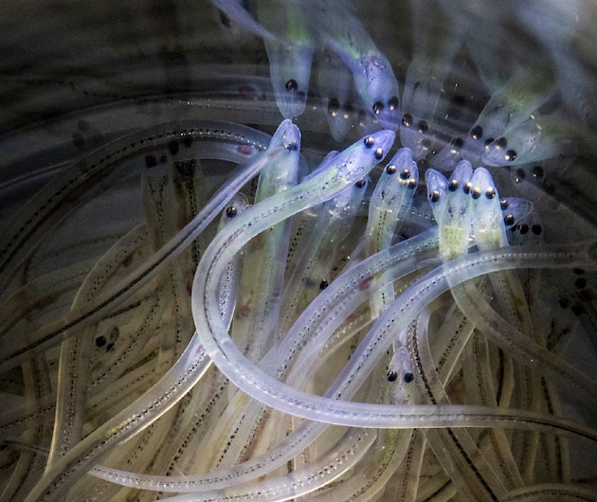
The glass-eel phenomenon
Notes:
The Antminer company, was one of the first to start selling “at home” mining kits, and with respect to their costs is generally there to assist the code/ program based traders to better mine their coins. I never purchased one of these myself.

Slide 12
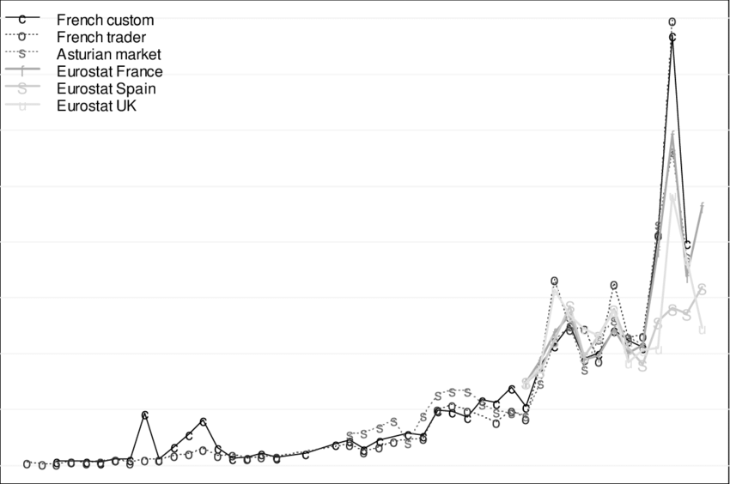
The glass-eel phenomenon
How Government and Politics become relevant when an economy booms.
- A catastrophe in Japan led to the export of “Elvers” which were NOT A DELICACY, however the supply in Japan was ruined (and will be for an extended period of time)
Notes:
The nuclear spill made it impossible for Japan to farm those elvers for about 100 years.

Slide 13
The glass-eel phenomenon
How the locals react…
“Short and sweet” is how Darrell Young, co-director of the Maine Elver Fishermen’s Association, put it when asked about the 2022 season. “This is the quickest we have ever filled our quota.”
The Waltham fisherman has fished for elvers for 30 years. He and several other fishermen collectively caught 80 pounds in eight days. He attributed the big catch to various factors including the Atlantic States Marine Fisheries Commission’s 2013 prohibition of harvesting of elvers at later stages of growth – when they are known as pigment, yellow and silver eels – along the Eastern Seaboard. The fact spring arrived early was another contributing factor.
The prices went from dollars, to thousands and sunk to $550 during Covid-19
- How do you think the locals felt about the future price of Elvers.
Notes:
https://www.mdislander.com/news/elvers-fetch-2-154-per-pound/article_b7b77c08-ba71-5ad6-a401-c75caaf11df1.html

Slide 14
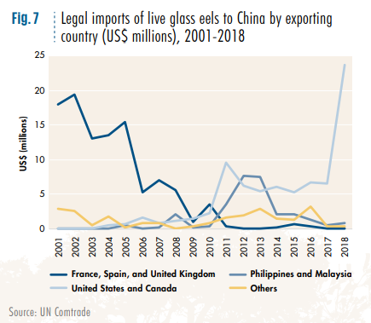
The glass-eel phenomenon
Notes:
https://www.unodc.org/documents/data-and-analysis/wildlife/2020/WWLC20_Chapter_7_Eels.pdf

Slide 15
Notes:
The arbitrage between competitors selling similar or identical products in different markets.

Slide 16
Notes:
The arbitrage between competitors selling similar or identical products in different markets, as fluctuations in price occur, the arbitrage opportunities become more substantial.

Slide 17
Crowded Spaces
Elvers fetch $2,154 per pound, and the area becomes crowded.
Real Estate Prices in Maine boom.
Politics in a small town in Maine.
The migration pattern of “Elvers” all of a sudden is a “thing of relevance”
The small town farmers all became millionaires, like they struck Gold.
In the United States, Maine’s elver fishery ranks among the most valuable on a per-pound basis. The baby eels are highly sought after in Japan, China and other Asian markets, where they are grown to market size. The translucent elvers also are a luxurious menu item – like caviar and truffles – in high-end restaurants around the globe.
https://www.europol.europa.eu/media-press/newsroom/news/glass-eel-traffickers-earned-more-eur-37-million-illegal-exports-to-asia
Notes:
The shift in demand outside Europe can be seen, for example, in export data on American glass eels. In the state of Maine, the catch quadrupled as prices increased twenty-fold in three years, from just under US$100 per pound (454g) in 2009 to just under US $2,000 per pound in 2012. The increase in both price and volume caused a sharp increase in the total market size in 2012 (Figure 8). In 2018, renewed demand for American eel was seen, albeit at lower prices, suggesting a competing source of supply…

Slide 18
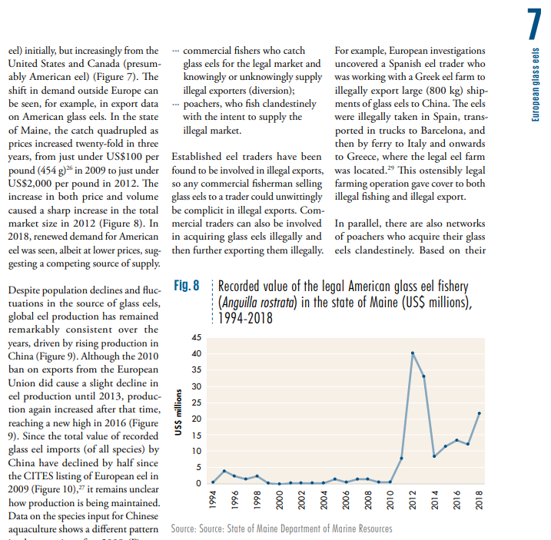
Notes:
The shift in demand outside Europe can be seen, for example, in export data on American glass eels. In the state of Maine, the catch quadrupled as prices increased twenty-fold in three years, from just under US$100 per pound (454g) in 2009 to just under US $2,000 per pound in 2012. The increase in both price and volume caused a sharp increase in the total market size in 2012 (Figure 8). In 2018, renewed demand for American eel was seen, albeit at lower prices, suggesting a competing source of supply…

Slide 19
Notes:
In 2014-2015, I coded and deployed a Bitcoin miner using a partition on my hard-drive and mined about two coins in roughly two months. > This of course, was when bitcoin was valued at roughly $350/BTC and I was generating anywhere from 5-50,000/ day. Everyday.

Slide 20
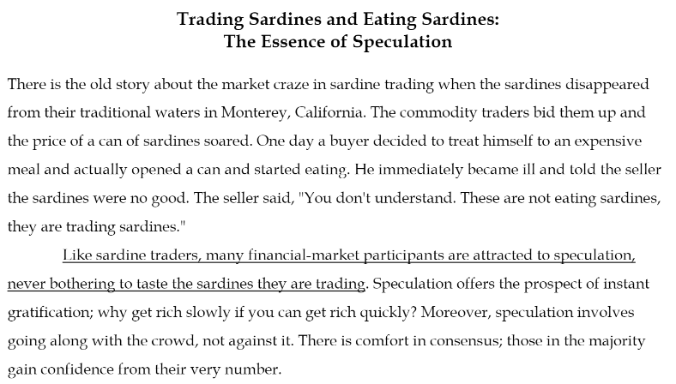
The Story of Trading Sardines
Seth Klarman’s Theories in “Margin of Safety”
Notes:
The difference between assets you keep on the shelf, and those you want to consume.
- Not limited to commodities, but for example – when you take an asset off the shelf and decide you want to sell it. - it may not taste as good when you decide to execute and turn your assets into cash for reinvestment.

Slide 21
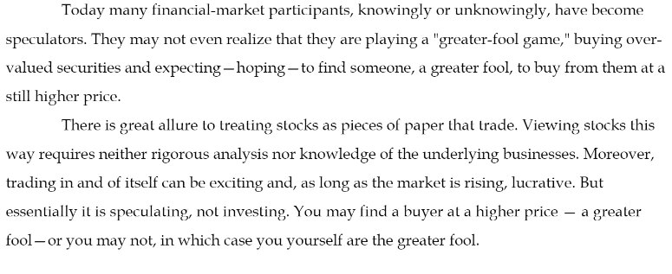
The Story of Trading Sardines
Seth Klarman’s Theories in “Margin of Safety”
Notes:
The difference between assets you keep on the shelf, and those you want to consume.
- Not limited to commodities, but for example – when you take an asset off the shelf and decide you want to sell it. - it may not taste as good when you decide to execute and turn your assets into cash for reinvestment.

Slide 22
mining VS. trading
Bitcoin and Cryptocurrency
Notes:
The difference between assets you harvest, which eventually need to be sold, or traded. - one way or the other, you must harvest the information and make sure you are getting the best product at the best price.

Slide 23
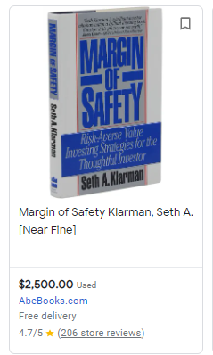
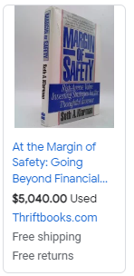
A TEXTBOOK EXAMPLE OF ARBITRAGE
Notes:
Are these two books the same.

Slide 24
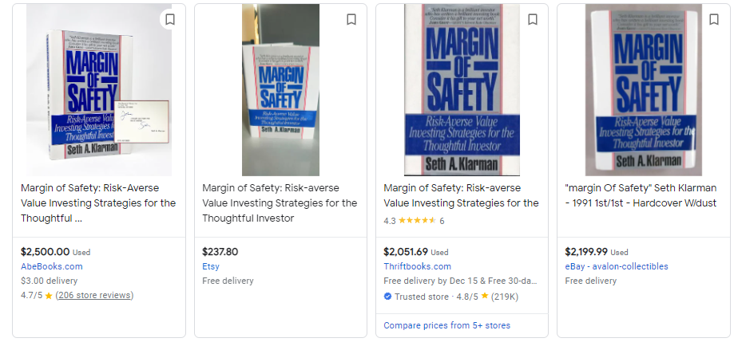
Notes:
Are these books the same? - Depends on who you are asking.

Slide 25
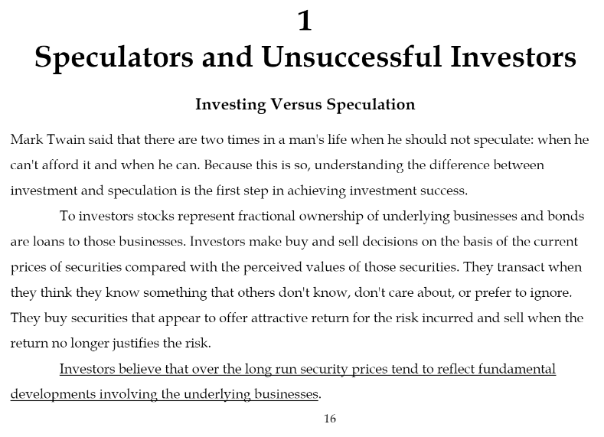
Illegal vs. Legal Arbitrage
Notes:
Speculation, should be limited in the scope of arbitrage; in fact – it should not exist, there should be no question as to “ AM I GOING TO MAKE MONEY “ on this transaction.

Slide 26
Illegal vs. Legal Arbitrage
Speculation, should be limited in the scope of arbitrage; in fact – it should not exist.
There should be no question as to “AM I GOING TO MAKE MONEY”
- or it is not a true arbitrage which is in the later slide that I will show you.
Notes:
Speculation, should be limited in the scope of arbitrage; in fact – it should not exist, there should be no question as to “ AM I GOING TO MAKE MONEY “ on this transaction.

Slide 27
What Is an Arbitrageur?
What Is an Arbitrageur?
EXAMPLE: The James Bond of Car Dealerships
- Not a Financial Vehicle, but still a vehicle of Arbitrage.
Notes:
When arbitrage exists – in any market. There is no question of “am I going to make a profit”.

Slide 28
Bitcoin Mining Procedure
Cryptocurrency Wallet
Mining Software
Mining Hardware
Notes:
You'll need a cryptocurrency wallet, mining software, and mining hardware to begin mining cryptocurrency. The equipment you need can be very expensive; however, the more you pay for equipment, the more profitable it can be.

Slide 29
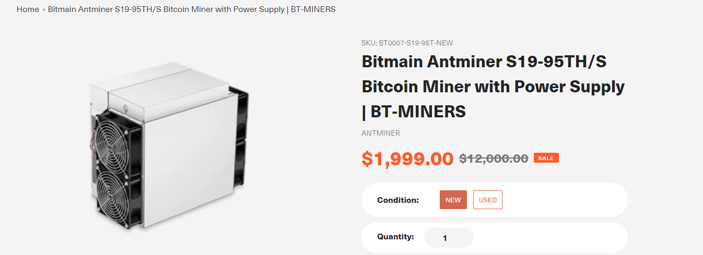
ANTMINER
Notes:
The Antminer company, was one of the first to start selling “at home” mining kits, and with respect to their costs is generally there to assist the code/ program based traders to better mine their coins.
- I never purchased one of these myself, and never needed to. - Generally what happens is, they are built to spec and in some cases, you will earn your money back before they become obsolete. - As new devices with more CPU speed arrive to market, you generally see the prices on the older ones come down, no different than a late model Ford Mustang.

Slide 30
What is an Antminer?
Notes:
- I never purchased one of these myself, and never needed to. So my advice is if you are thinking of purchasing one of these just give me the money instead. - Generally what happens is, they are built to spec and in some cases, you will earn your money back before they become obsolete. - As new devices with more CPU speed arrive to market, you generally see the prices on the older ones come down, no different than a late model Ford Mustang.

Slide 31
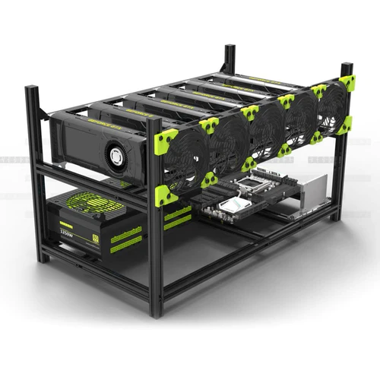
What is an Antminer?
The barrier of entry using the hardware approach is no different than buying an office building to rent out all of the offices so you can have a free office.
Basically, if all you want is an office, just get the office and you can make just as much money without having to maintain an entire building.
Notes:
You'll need a cryptocurrency wallet, mining software, and mining hardware to begin mining cryptocurrency. The equipment you need can be very expensive; however, the more you pay for equipment, the more profitable it can be.
The barrier of entry using the hardware approach is no different than buying an office building to rent out all of the offices so you can have a free office.
Basically, if all you want is an office, just get the office and you can make just as much money without having to maintain an entire building.

Slide 32
Bitcoin Mining Procedure
Cryptocurrency Wallet
Mining Software
Mining Harware
Notes:
You'll need a cryptocurrency wallet, mining software, and mining hardware to begin mining cryptocurrency. The equipment you need can be very expensive; however, the more you pay for equipment, the more profitable it can be.

Slide 33

Bitcoin Mining
Notes:
Cryptocurrency Wallet, to store the Bitcoins, or whatever cryptocurrency you are interested in mining.
Mining Software, which we will walk about a little later.
Mining Hardware, like the Antminer, or other ways you can configure your CPU, GPU, and PC/ or laptop to network in P2P mining.

Slide 34
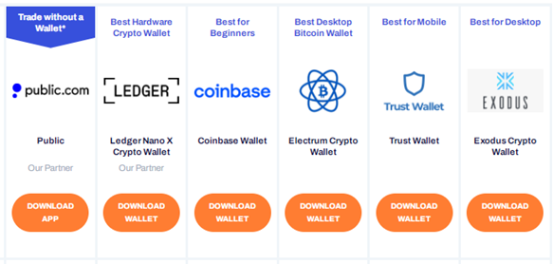
Bitcoin Wallets
Notes:
You'll need a cryptocurrency wallet, mining software, and mining hardware to begin mining cryptocurrency. The equipment you need can be very expensive; however, the more you pay for equipment, the more profitable it can be.
It doesn’t make that big of a difference of which wallet you are using. - typically you are just pointing whatever mining software you are using to point your earning into a digital wallet somewhere.

Slide 35
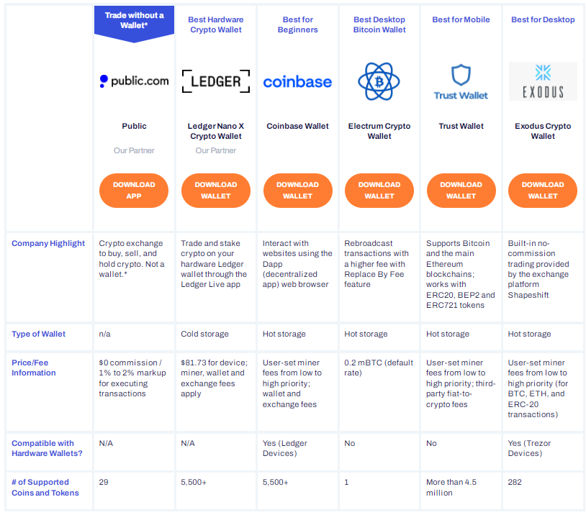
Bitcoin Wallets
Notes:
It doesn’t make that big of a difference of which wallet you are using. - typically you are just pointing whatever mining software you are using to point your earning into a digital wallet somewhere.

Slide 36
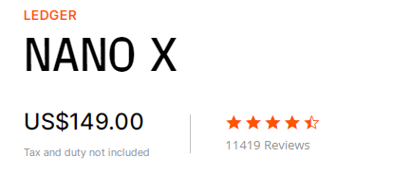

Bitcoin Wallets
Notes:
Waste of money, don’t pay for what you don’t need unless you just want to show off.

Slide 37
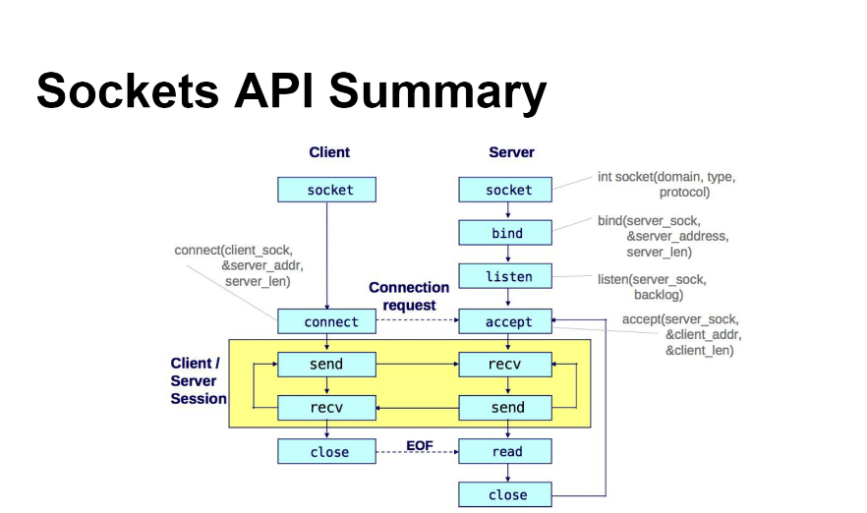
P2P negotiation cycles in the cloud.
Notes:
Explain how this and mining in a p2p environment are one-in-the-same on the white board.

Slide 38
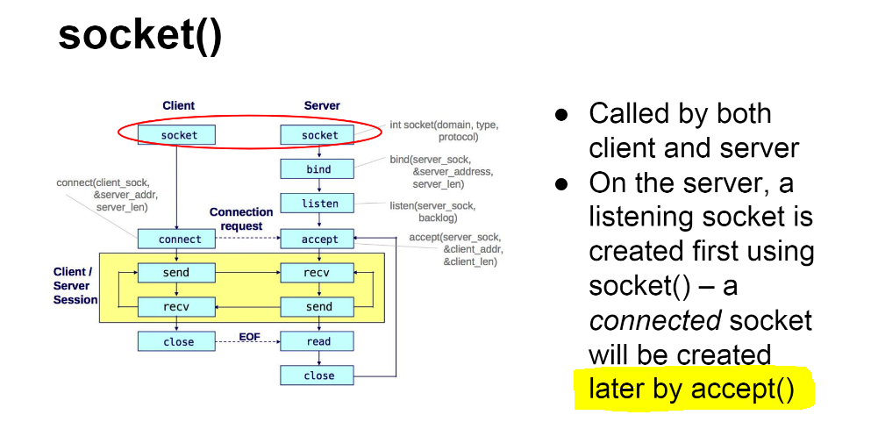
You wait in a queue until your machine has solved the hash
Notes:
Explain how this and mining in a p2p environment are one-in-the-same on the white board.

Slide 39
Program Trading: Financial Information Exchange
FIX 4.x, using quickfix/1.15.1
Introduction to what is ahead.
Notes:
quickfix/1.15.1

Slide 40
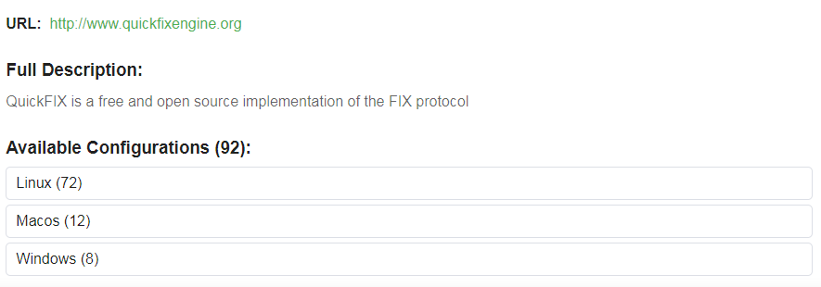
Program Trading: Financial Information Exchange
Notes:
quickfix/1.15.1

Slide 41
Step-by-step how to set up a fix engine on your PC
Notes:
The interactive brokers fix engine.

Slide 42
Program Trading: Cryptocurrency Smart Contracts
Different API solutions offered in the market.
The interactive brokers fix engine.
Step-by-step how to set up a fix engine on your laptops.

Slide 43
Program Trading: Smart Contracts - Day II: how to use the FIX information exchange
Cryptocurrency
Equities
Fixed Income
Derivatives
Futures
Commodities
Notes:
We are going to review how to obtain, store, and use Crypto coding with C++
https://conan.io/center/quickfix?os=Windows&tab=overview

Slide 44
Program Trading: Smart Contracts, FIX tags. - https://www.onixs.biz/fix-dictionary/4.2/fields_by_tag.html - https://quickfixengine.org/c/documentation/
Notes:
How to use regression strategies to identify arbitrage
- And the similarities.

Slide 45
Program Trading: Smart Contracts, FIX tags. - Day II: Regression strategies to identify arbitrage
Cryptocurrency
Equities
Fixed Income
Derivatives
Futures
Commodities
Notes:
How to use regression strategies to identify arbitrage
- And the similarities.

Slide 46
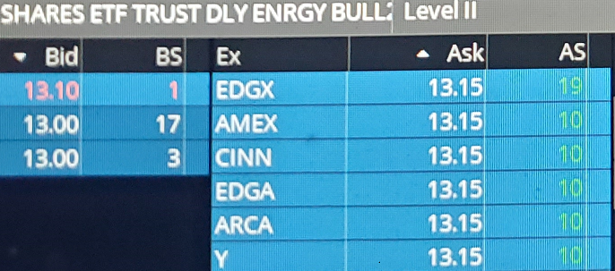
Program Trading: Market Making. - Day II: How to observe supply and demand to determine values.
Working with the stack.
How to “melt” an iceberg order.
Notes:
How to use regression strategies to identify arbitrage
Explain what this means, and how to melt an iceberg.
Do this example of the whiteboard to explain how the stack can be manipulated as an aggressor and as a liquidity provider.

Slide 47
Program Trading: Arbitrage. - Day II: How to observe bid & ask price arbitrage.
Working with the stack to identify arbitrage.
How to “intelligently” execute an arbitrage order.
Notes:
How to use regression strategies to identify arbitrage
Explain market depth.
Do this example of the whiteboard to explain how the stack can be manipulated as an aggressor and as a liquidity provider.

Slide 48
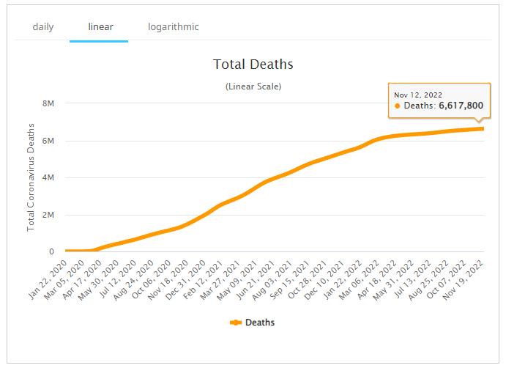
Program Trading: Forecasting Values. - Day II: How to use regression strategies to forecast values.
Notes:
How to use regression strategies to identify arbitrage
- And why they are all the same.

Slide 49
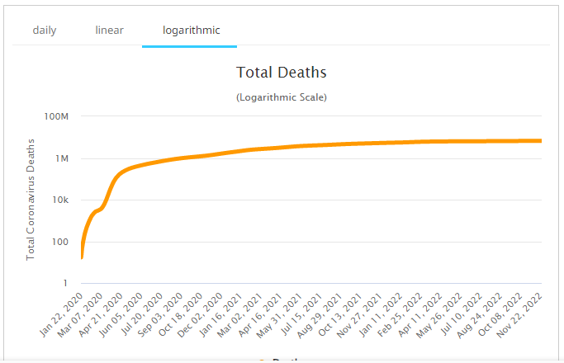
Program Trading: Forecasting Values. - Day II: How to use regression strategies to forecast values.
Notes:
How to use regression strategies to identify arbitrage
- And why they are all the same.

Slide 50
Program Trading. - Day II: How to use regression strategies to forecast values.
https://covid.ourworldindata.org/data/owid-covid-data.xlsx
This table has about 250,000 rows of information which we will use to forecast deaths in each country.
No matter which country you select, your program should be able to pin the number of deaths in the future.
Notes:
How to use regression strategies to identify arbitrage
- And why they are all the same.

Slide 51
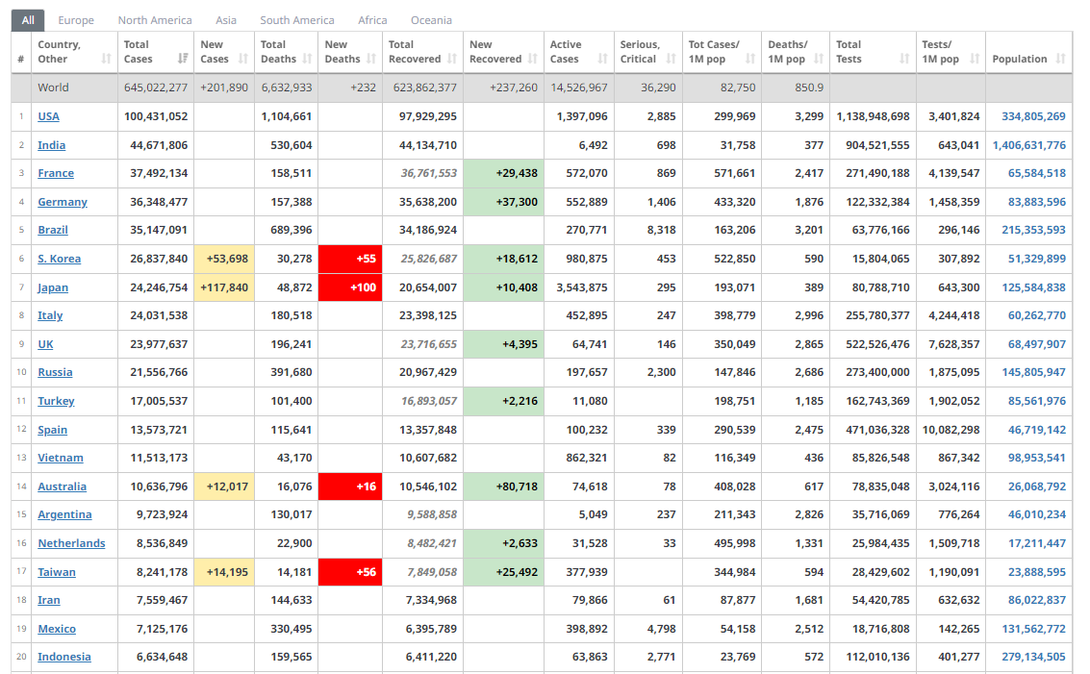
Program Trading. - Day II: How to use regression strategies to forecast values.
Notes:
How to use regression strategies to identify arbitrage
- And why they are all the same no matter what information you are trying to forecast, as long as there are enough data points in the past.

Slide 52
Program Trading - Day II: ETL Strategies using Memory Mapped Files
Flat file storage solutions
The advantages over SQL, Mongo, or anything.
Notes:
Discuss the in-depth process of ETL on the whiteboard using flat file storage solutions and its advantages over SQL, Mongo, or anything.

Slide 53
Program Trading - Day II: ETL Strategies using Memory Mapped Files
Extract
Transform
Load
Notes:
Discuss the in-depth process of ETL on the whiteboard using flat file storage solutions and its advantages over SQL, Mongo, or anything.

Slide 54
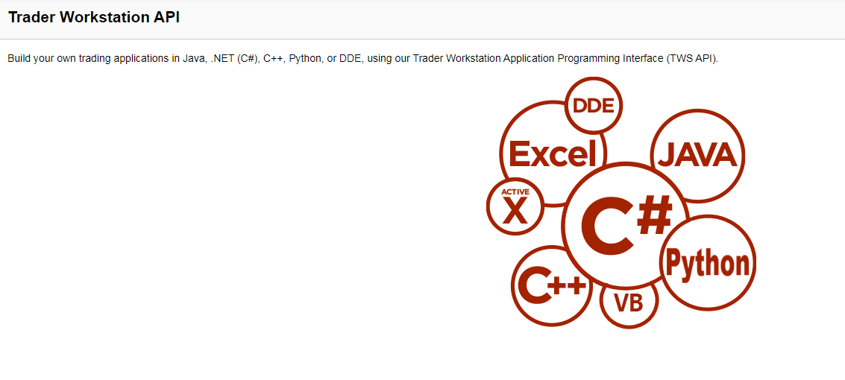
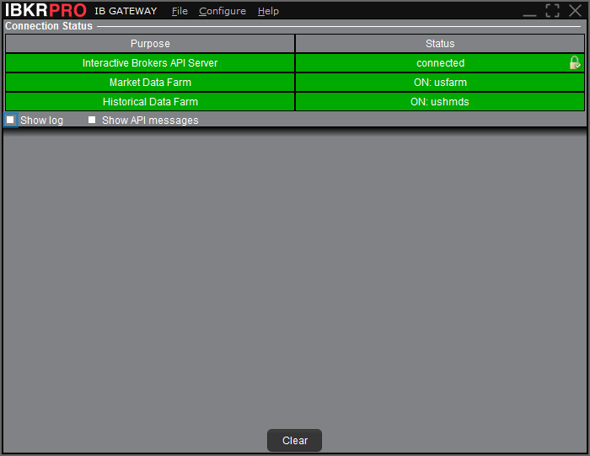

Slide 55
https://www.interactivebrokers.com/en/trading/tws-offline-installers.php
https://www.interactivebrokers.com/en/trading/ibgateway-latest.php

Slide 56
https://www.interactivebrokers.com/en/trading/tws-offline-installers.php
https://www.interactivebrokers.com/en/trading/ibgateway-latest.php
The API Stable for Windows includes the Java, C++, C#/.NET, ActiveX, and DDE APIs, along with sample code and spreadsheets. The API Latest for Windows (v1014) additionally includes the Python API.
The API Stable for Mac/Unix (v976) includes the Java and Posix C++ API source and sample. The API Latest for Mac/Unix (v1014) additionally includes the Python API. (Excel APIs are only available on Windows)

Slide 57
Program Trading: Smart Contracts - 12/7: Crypto coding with C++

Slide 58
Program Trading: Smart Contracts - 12/8: Crypto coding with C++

Slide 59
Program Trading: Smart Contracts - 12/9: Crypto coding with C++

Slide 60
Monday, December 12th, 2022
How Markets Endorse New Crypto Technology
- Last week’s assignment.
REVIEW STUDENT TWS APPLICATION
DAY ½
DAY 1: HASKELL
DAY 2: GOLANG
DAY 3/ 4/ 5/
WE WILL BE WORKING ON THE TWS ENHACEMENTS IN “OTHER PROGRAMMING LANGUAGES.
Notes:
NOTE: Week of 12/12 – 12/13 in class, project/lab in class the week of 12/12
https://anilmainali.github.io/2016-06-01-How-To-Install-Chocolatey-on-Windows-7/
https://anilmainali.github.io/2016-06-01-How-To-Install-Chocolatey-on-Windows-7/
https://community.chocolatey.org/packages/cabal

Slide 61
HASKELL
Coding with other languages
Haskell
Golang
Python/ C#/ Java Data Structures in the TWS
Notes:
NOTE: Week of 12/12 – 12/13 in class, project/lab in class the week of 12/12 – 12/16

Slide 62
HASKELL
1. Explicit Language
− In Haskell we will tell our computer "what it is?“
2. Laziness
− Haskell is a lazy language.
− Haskell won't evaluate any expression without any reason.
− The engine will start working only when it is required to evaluate that specific expression.
3. Executable Functions
− Haskell Applications are a series of functions.
− A collection of numerous small Haskell applications can compile into one larger body of "Program".
- Think more like a sequence of events.
4. Statically Typed
− A series of variables along with their type.
5. Type interference language.
- The Haskell compiler is intelligent enough to figure out the type of the variable declared.
- You don't have to explicitly mention the type of the variable used.
Notes:
NOTE: Week of 12/12 – 12/13 in class, project/lab in class the week of 12/12 – 12/16

Slide 63
HASKELL
1. EXPLICIT LANGUAGE
We will tell our computer "what it is?“
Notes:
NOTE: Week of 12/12 – 12/13 in class, project/lab in class the week of 12/12 – 12/16

Slide 64
HASKELL
2. LAZINESS
− Haskell is a lazy language.
− Haskell won't evaluate any expression without any reason.
− The engine will start working only when it is required to evaluate that specific expression.
Notes:
NOTE: Week of 12/12 – 12/13 in class, project/lab in class the week of 12/12 – 12/16

Slide 65
HASKELL
3. EXECUTABLE FUNCTIONS
− Haskell Applications are a series of functions.
− A collection of numerous small Haskell applications can compile into one larger body of "Program".
- Think more like a sequence of events.
Notes:
https://www.tutorialspoint.com/compile_haskell_online.php

Slide 66
HASKELL
4. STATICALLY TYPED
− A series of variables along with their type.
Notes:
https://www.tutorialspoint.com/compile_haskell_online.php

Slide 67
HASKELL
4. STATICALLY TYPED
main = putStrLn "Hello World \n Go Blue"
Notes:
https://www.tutorialspoint.com/compile_haskell_online.php
main = putStrLn "Hello World \n Go Blue!!!"

Slide 68
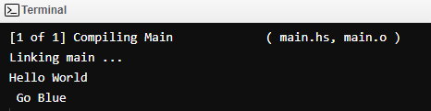
HASKELL
4. STATICALLY TYPED
main = putStrLn "Hello World \n Go Blue!!!"
Notes:
https://www.tutorialspoint.com/compile_haskell_online.php
main = putStrLn "Hello World \n Go Blue!!!"

Slide 69
HASKELL
4. . TYPE INTERFERENCE LANGUAGE
- The Haskell compiler is intelligent enough to figure out the type of the variable declared.
- You don't have to explicitly mention the type of the variable used.
Notes:
https://www.tutorialspoint.com/compile_haskell_online.php
main = putStrLn "Hello World \n Go Blue!!!"

Slide 70
HASKELL
https://www.haskell.org/downloads
Notes:
https://www.tutorialspoint.com/compile_haskell_online.php
main = putStrLn "Hello World \n Go Blue!!!"

Slide 71
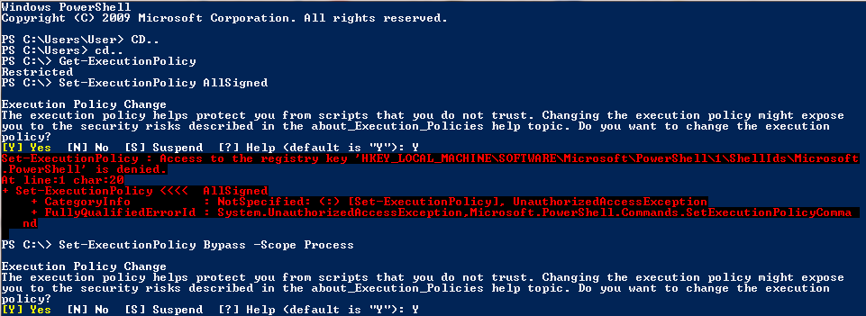
HASKELL
ENVIRONMENT
Notes:
https://www.tutorialspoint.com/compile_haskell_online.php
main = putStrLn "Hello World \n Go Blue!!!"

Slide 72
HASKELL
I will be doing this in POWERSHELL.
> YOU CAN USE ANY OTHER IDE OR USE AN ONLINE IDE FOR THE PROJECT WE WILL BE DOING IN CLASS.
https://www.haskell.org/downloads
Notes:
https://www.tutorialspoint.com/compile_haskell_online.php
main = putStrLn "Hello World \n Go Blue!!!"

Slide 73
HASKELL
MAC
https://www.haskell.org/platform/mac.html
WINDOWS
https://www.haskell.org/platform/windows.html
LINUX
https://www.haskell.org/platform/linux.html
Notes:
https://www.tutorialspoint.com/compile_haskell_online.php
- main = putStrLn "Hello World \n Go Blue!!!“
https://www.jdoodle.com/execute-haskell-online/

Slide 74
COMMENTING OUT BLOCKS
-- EXPLICIT/ LITERAL EXPRESSIONS
addIntegers :: Integer -> Integer -> Integer
addIntegers x y = x + y
-- PROGRAM
main :: IO ()
main = do
-- THIS "putStr command will do whatever you tell the teleprompter to write immediately.
putStr "Sum of x + y = "
print(addIntegers 2 2)

Slide 75
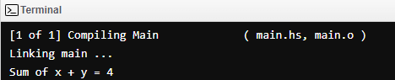
COMMENTING OUT BLOCKS
-- EXPLICIT/ LITERAL EXPRESSIONS
addIntegers :: Integer -> Integer -> Integer
addIntegers x y = x + y
-- PROGRAM
main :: IO ()
main = do
-- THIS "putStr command will do whatever you tell the teleprompter to write immediately.
putStr "Sum of x + y = "
print(addIntegers 2 2)
Notes:
https://www.jdoodle.com/execute-haskell-online/
https://www.tutorialspoint.com/compile_haskell_online.php

Slide 76
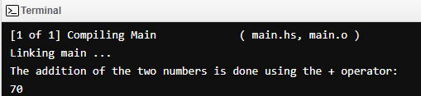
MATHEMATICAL OPERATORS
ADDITION +
main = do
let variable1 = 2
let variable2 = 3
putStrLn "The addition of the two numbers is done using the + operator:"
print(variable1 + variable2)
Notes:
https://www.jdoodle.com/execute-haskell-online/
https://www.tutorialspoint.com/compile_haskell_online.php

Slide 77
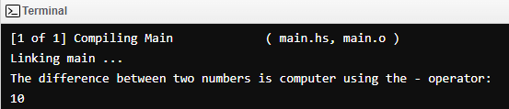
MATHEMATICAL OPERATORS
SUBTRACTION -
main = do
let variable1 = 10
let variable2 = 0
putStrLn "The difference between two numbers is computer using the - operator:"
print(variable1 - variable2)
Notes:
https://www.jdoodle.com/execute-haskell-online/
https://www.tutorialspoint.com/compile_haskell_online.php

Slide 78
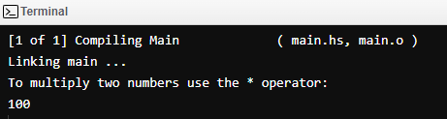
MATHEMATICAL OPERATORS
PRODUCT *
main = do
let variable1 = 10
let variable2 = 10
putStrLn "To multiply two numbers use the * operator: "
print(variable1 * variable2)
Notes:
https://www.jdoodle.com/execute-haskell-online/
https://www.tutorialspoint.com/compile_haskell_online.php

Slide 79
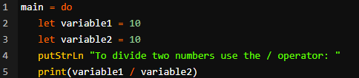
MATHEMATICAL OPERATORS
QUOTIENT /
main = do
let variable1 = 10
let variable2 = 10
putStrLn "To divide two numbers use the / operator: "
print(variable1 / variable2)
Notes:
https://www.jdoodle.com/execute-haskell-online/
https://www.tutorialspoint.com/compile_haskell_online.php

Slide 80
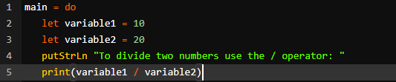
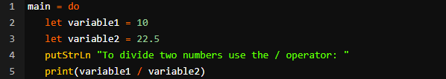
MATHEMATICAL OPERATORS
QUOTIENT /
Notes:
https://www.jdoodle.com/execute-haskell-online/
https://www.tutorialspoint.com/compile_haskell_online.php

Slide 81
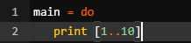
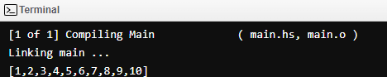
MATHEMATICAL OPERATORS
SEQUENTIAL OPERATOR [..]
Notes:
https://www.jdoodle.com/execute-haskell-online/
https://www.tutorialspoint.com/compile_haskell_online.php

Slide 82
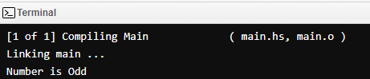
DECISIONS
if<Condition> then <True-Value>else <False-Value>
One if statement with an else statement.
The instruction in the else block will execute only when the given Boolean condition fails to satisfy.
main = do
let var = 21
if var `rem` 2 == 0
then putStrLn "Number is Even"
else putStrLn "Number is Odd"
Notes:
One if statement with an else statement.
The instruction in the else block will execute only when the given Boolean condition fails to satisfy.

Slide 83
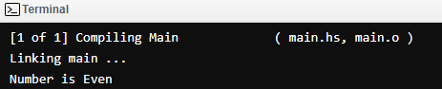
DECISIONS
if<Condition> then <True-Value>else <False-Value>
main = do
let var = 24
if var `rem` 2 == 0
then putStrLn "Number is Even"
else putStrLn "Number is Odd"
Notes:
One if statement with an else statement.
The instruction in the else block will execute only when the given Boolean condition fails to satisfy.

Slide 84
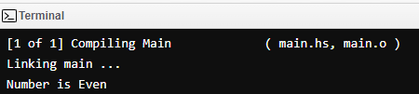
DECISIONS…
ACCORDING TO HASKELL, 0 = EVEN.
main = do
let var = 0
if var `rem` 2 == 0
then putStrLn "Number is Even"
else putStrLn "Number is Odd"
Notes:
One if statement with an else statement.
The instruction in the else block will execute only when the given Boolean condition fails to satisfy.

Slide 85
Haskell - Nested if-else statement
main = do
let var = 26
if var == 0
then putStrLn "Number is zero"
else if var `rem` 2 == 0
then putStrLn "Number is Even"
else putStrLn "Number is Odd"
Notes:
One if statement with an else statement.
The instruction in the else block will execute only when the given Boolean condition fails to satisfy.

Slide 86
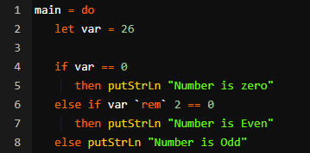
Haskell - Nested if-else statement
Notes:
One if statement with an else statement.
The instruction in the else block will execute only when the given Boolean condition fails to satisfy.

Slide 87
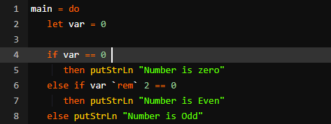
Haskell - Nested if-else statement
Notes:
How many outputs do we get here.
One if statement with an else statement.
The instruction in the else block will execute only when the given Boolean condition fails to satisfy.

Slide 88
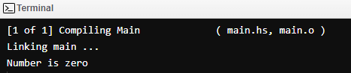
Haskell - Nested if-else statement
Notes:
How many outputs do we get here.
One if statement with an else statement.
The instruction in the else block will execute only when the given Boolean condition fails to satisfy.

Slide 89
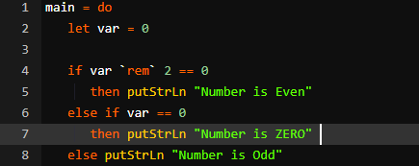
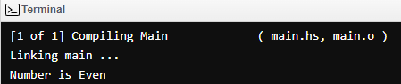
Haskell - Nested if-else statement
Notes:
How many outputs do we get here.
One if statement with an else statement.
The instruction in the else block will execute only when the given Boolean condition fails to satisfy.

Slide 90
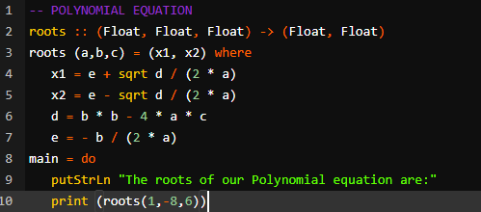
Haskell – Where Function
Notes:
-- POLYNOMIAL EQUATION
roots :: (Float, Float, Float) -> (Float, Float)
roots (a,b,c) = (x1, x2) where
x1 = e + sqrt d / (2 * a)
x2 = e - sqrt d / (2 * a)
d = b * b - 4 * a * c
e = - b / (2 * a)
main = do
putStrLn "The roots of our Polynomial equation are:"
print (roots(1,-8,6))

Slide 91
HASKELL
DATA TYPES
Notes:
https://www.tutorialspoint.com/compile_haskell_online.php
main = putStrLn "Hello World \n Go Blue!!!"

Slide 92
BUILT IN DATA TYPES
“Inbuilt” Type Classes
On Board Navigation
Notes:
https://www.tutorialspoint.com/compile_haskell_online.php
main = putStrLn "Hello World \n Go Blue!!!"

Slide 93
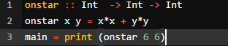
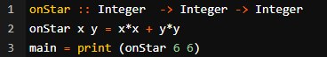
interchangeable
Notes:
https://www.tutorialspoint.com/compile_haskell_online.php
main = putStrLn "Hello World \n Go Blue!!!"

Slide 94
Int
Int is a type class representing the Integer types data.
Every whole number within the range of 2147483647 to -2147483647
Notes:
https://www.tutorialspoint.com/compile_haskell_online.php
main = putStrLn "Hello World \n Go Blue!!!"

Slide 95
Integer
-- EXPLICIT/ LITERAL EXPRESSIONS
addIntegers :: Integer -> Integer -> Integer
addIntegers x y = x + y
-- PROGRAM
main :: IO ()
main = do
-- THIS "putStr command will do whatever you tell the teleprompter to write immediately.
putStr "Sum of x + y = "
print(addIntegers 2 2)
Notes:
https://www.tutorialspoint.com/compile_haskell_online.php
main = putStrLn "Hello World \n Go Blue!!!"

Slide 96

Integer
Notes:
https://www.tutorialspoint.com/compile_haskell_online.php
main = putStrLn "Hello World \n Go Blue!!!"

Slide 97
Integer
Integer can be considered as a superset of Int.
Not bounded by any number.
Hence an Integer can be of any length without any limitation.
Notes:
https://www.tutorialspoint.com/compile_haskell_online.php
main = putStrLn "Hello World \n Go Blue!!!"

Slide 98


Integer
Hence an Integer can be of any length without any limitation.
Notes:
https://www.tutorialspoint.com/compile_haskell_online.php
main = putStrLn "Hello World \n Go Blue!!!"

Slide 99


Double
Hence the output can be another variable, without any limitation in this case.
Notes:
https://www.tutorialspoint.com/compile_haskell_online.php
main = putStrLn "Hello World \n Go Blue!!!"

Slide 100


Double
Hence the output can be another variable, without any limitation in this case.
Notes:
I don’t like this, because in a dynamic environment you don’t know how to easily control the output.

Slide 101


Float
-- Float as the input and yields another float value as the output. (maybe)
Notes:
I don’t like this, because in a dynamic environment you don’t know how to easily control the output.

Slide 102
Float
-- Float as the input and yields another float value as the output. (maybe)
Notes:
I don’t like this, because in a dynamic environment you don’t know how to easily control the output.

Slide 103


Float
-- Float as the input and yields another float value as the output.
Notes:
I don’t like this, because in a dynamic environment you don’t know how to easily control the output.

Slide 104


Bool
Notes:
I don’t like this, because in a dynamic environment you don’t know how to easily control the output.

Slide 105
Bool
Notes:
I don’t like this, because in a dynamic environment you don’t know how to easily control the output.

Slide 106


Bool
Notes:
I don’t like this, because in a dynamic environment you don’t know how to easily control the output.

Slide 107


Char
Notes:
I don’t like this, because in a dynamic environment you don’t know how to easily control the output.

Slide 108

Char
Notes:
I don’t like this, because in a dynamic environment you don’t know how to easily control the output.

Slide 109


Char
Notes:
I don’t like this, because in a dynamic environment you don’t know how to easily control the output.

Slide 110

TYPE SETTING
Notes:
I don’t like this, because in a dynamic environment you don’t know how to easily control the output.

Slide 111


EQ OPERATORS
Notes:
I don’t like this, because in a dynamic environment you don’t know how to easily control the output.

Slide 112

ORD
<=
Notes:
">", "<", "<=", ">=", "compare"

Slide 113
ORD
main = do
let var = 26
if var <= 0
then putStrLn "Number is less than or equal to zero"
else if var `rem` 2 == 0
then putStrLn "Number is Even"
else putStrLn "Number is Odd"
<=
Notes:
">", "<", "<=", ">=", "compare"

Slide 114

ORD
main = do
let var = 26
if var <= 0
then putStrLn "Number is less than or equal to zero"
else if var `rem` 2 == 0
then putStrLn "Number is Even"
else putStrLn "Number is Odd"
<=
Notes:
">", "<", "<=", ">=", "compare"

Slide 115


ORD
main = do
let var = 26
if var <= 30
then putStrLn "Number is less than or equal to zero"
else if var `rem` 2 == 0
then putStrLn "Number is Even"
else putStrLn "Number is Odd"
<=
Notes:
">", "<", "<=", ">=", "compare"

Slide 116

ORD
>=
Notes:
">", "<", "<=", ">=", "compare"

Slide 117

ORD
>
Notes:
">", "<", "<=", ">=", "compare"

Slide 118

ORD
<
Notes:
">", "<", "<=", ">=", "compare"

Slide 119
BUILT IN DATA TYPES
“Inbuilt” Type Classes
On Board Navigation
Notes:
https://www.tutorialspoint.com/compile_haskell_online.php
main = putStrLn "Hello World \n Go Blue!!!"

Slide 120
READ
readInt
The output at the end is inevitable , in this case.
Notes:
">", "<", "<=", ">=", "compare"

Slide 121

SHOW
show
Show has a functionality to print its argument as a String.
Notes:
Show has a functionality to print its argument as a String.

Slide 122

SHOW
show
Show has a functionality to print its argument as a String.
Notes:
Show has a functionality to print its argument as a String.

Slide 123

ENUMERABLES
succ
Succ shows you the next value. - the successor.
Notes:
Succ shows you the next value. - the successor.

Slide 124

ENUMERABLES
pred
pred shows you the prior value in a sequence.
Notes:
pred shows you the prior value in a sequence.

Slide 125
ENUMERABLES
pred
pred shows you the prior value in a sequence.
Notes:
pred shows you the prior value in a sequence.

Slide 126

ENUMERABLES
Reminder: Hence an Integer can be of any length without any limitation.
maxBound
minBound
Notes:
Keep in mind that "data" is a keyword here and all user-defined types in Haskell always start with a capital letter.

Slide 127


Numeric Data Review
Notes:
Numeric Data Review

Slide 128

CUSTOM TUNED CLASSES
Keep in mind that "data" is a keyword here and all user-defined types in Haskell always start with a capital letter.
circle
Notes:
Keep in mind that "data" is a keyword here and all user-defined types in Haskell always start with a capital letter.

Slide 129


CUSTOM TUNED CLASSES
Keep in mind that “add" is a keyword her.
Custom functions and formulae
Notes:
Keep in mind that "data" is a keyword here and all user-defined types in Haskell always start with a capital letter.

Slide 130

CUSTOM TUNED CLASSES
Keep in mind that “mult" is a keyword here.
Custom functions and formulae
Notes:
Keep in mind that "data" is a keyword here and all user-defined types in Haskell always start with a capital letter.

Slide 131


CUSTOM TUNED CLASSES
Keep in mind that “fact" is a keyword here.
Custom functions and formulae
Notes:
Keep in mind that "data" is a keyword here and all user-defined types in Haskell always start with a capital letter.

Slide 132
CUSTOM TUNED CLASSES
Keep in mind that “fact" is a keyword here.
Custom functions and formulae
Notes:
Keep in mind that "data" is a keyword here and all user-defined types in Haskell always start with a capital letter.

Slide 133
BUILT IN DATA TYPES
“Inbuilt” Type Classes
On Board Navigation
RECURSION
Notes:
https://www.tutorialspoint.com/compile_haskell_online.php
main = putStrLn "Hello World \n Go Blue!!!"

Slide 134
RECURSION
Recursion is a situation where a function calls itself repeatedly.
Don’t get it confused with regression –we’ll talk about that later today.
Haskell does not provide any facility of looping any expression for more than once.
FOR A HIGH FUNCTIONING PROGRAM.
Haskell wants you to break your entire functionality into a collection of different functions.
The goal is to use recursion techniques to implement your functionality explicitly.
Custom functions and formulae
Notes:
Keep in mind that "data" is a keyword here and all user-defined types in Haskell always start with a capital letter.

Slide 135


RECURSION
In the following example, we have used both pattern matching and recursion to calculate the factorial of 5.
fact :: Int -> Int
fact 0 = 1
fact n = n * fact ( n - 1 )
main = do
putStrLn "The factorial of 5 is:"
print (fact 5)
Custom functions and formulae
Notes:
Keep in mind that "data" is a keyword here and all user-defined types in Haskell always start with a capital letter.

Slide 136

String Manipulation
toUpper
Notes:
Keep in mind that "data" is a keyword here and all user-defined types in Haskell always start with a capital letter.

Slide 137


String Manipulation
toLower
Notes:
Keep in mind that "data" is a keyword here and all user-defined types in Haskell always start with a capital letter.

Slide 138

A lambda function is denoted by "\" character.
main = do
putStrLn "The successor of 77 is:"
print ((\x -> x + 1) 77)
Lambda Lambda Lambda
Notes:
Keep in mind that "data" is a keyword here and all user-defined types in Haskell always start with a capital letter.

Slide 139

So easy, even a Lambda Expression can do it.
Which is worthless.
Lambda Lambda Lambda
Notes:
Keep in mind that "data" is a keyword here and all user-defined types in Haskell always start with a capital letter.

Slide 140
Some additional Expressions
-- HEAD
main = do
let x = [1..10]
putStrLn "Our list of HEAD is:"
print (x)
putStrLn "The first element of the list is:"
print (head x)
Lambda Lambda Lambda
Notes:
Keep in mind that "data" is a keyword here and all user-defined types in Haskell always start with a capital letter.

Slide 141
Some additional Expressions
-- TAIL
main = do
let x = [1..10]
putStrLn "Our list of TAIL is:"
print (x)
putStrLn "The tail of our list is:"
print (tail x)
Lambda Lambda Lambda
Notes:
Keep in mind that "data" is a keyword here and all user-defined types in Haskell always start with a capital letter.

Slide 142
Some additional Expressions
-- LAST
main = do
let x = [1..10]
putStrLn "Our list of LAST IS:"
print (x)
putStrLn "The last element of our list is:"
print (last x)
Lambda Lambda Lambda
Notes:
Keep in mind that "data" is a keyword here and all user-defined types in Haskell always start with a capital letter.

Slide 143
Some additional Expressions
-- Init works exactly as the opposite of TAIL function
main = do
let x = [1..10]
putStrLn "Our list of INIT:"
print (x)
putStrLn "Our list without the last entry:"
print (init x)
Lambda Lambda Lambda
Notes:
Keep in mind that "data" is a keyword here and all user-defined types in Haskell always start with a capital letter.

Slide 144
Some additional Expressions
-- NULL function
main = do
let x = [1..10]
putStrLn "Our list is maybe empty:"
print (x)
putStrLn "Is our list actually empty though?"
print (null x)
Lambda Lambda Lambda
Notes:
Keep in mind that "data" is a keyword here and all user-defined types in Haskell always start with a capital letter.

Slide 145
Some additional Expressions
-- REVERSE function
main = do
let x = [1..10]
putStrLn "Our list NOT in reverse is:"
print (x)
putStrLn "The list in Reverse Order is:"
print (reverse x)
Lambda Lambda Lambda
Notes:
Keep in mind that "data" is a keyword here and all user-defined types in Haskell always start with a capital letter.

Slide 146
Some additional Expressions
-- LENGTH function
main = do
let x = [1..10]
putStrLn "Our list is:"
print (x)
putStrLn "The length of this list is:"
print (length x)
Lambda Lambda Lambda
Notes:
Keep in mind that "data" is a keyword here and all user-defined types in Haskell always start with a capital letter.

Slide 147
BUILT IN DATA TYPES
“Inbuilt” Type Classes
On Board Navigation
STRING AND THINGS
Notes:
https://www.tutorialspoint.com/compile_haskell_online.php
main = putStrLn "Hello World \n Go Blue!!!"

Slide 148
Drop it
main = print(drop 5 ([1 .. 10]))
Just Remember: Lambda Lambda Lambda
Notes:
The code drops the first 5 elements from the supplied list and prints the remaining 5 elements.

Slide 149
Take it
main = print(take 5 ([1 .. 10]))
Just Remember: Lambda Lambda Lambda
Notes:
The code generates a sub-string containing 5 first elements.
Similar to head, but still… lambda lambda lambda.
I don’t use this ANYWHERE in my code, ever. For a pointer.

Slide 150


Maximum
Minimum
Just Remember: Lambda Lambda Lambda
Notes:
The code generates a sub-string containing 5 first elements.
Similar to head, but still… lambda lambda lambda.
I don’t use this ANYWHERE in my code, ever. For a pointer.

Slide 151

Sum all elements in a series
Just Remember: Lambda Lambda Lambda
Notes:
The code generates a sub-string containing 5 first elements.
Similar to head, but still… lambda lambda lambda.
I don’t use this ANYWHERE in my code, ever. For a pointer.

Slide 152


Multiply all elements in a series
Just Remember: Lambda Lambda Lambda
Notes:
The code generates a sub-string containing 5 first elements.
Similar to head, but still… lambda lambda lambda.
I don’t use this ANYWHERE in my code, ever. For a pointer.

Slide 153

Sum all elements in a series
Just Remember: Lambda Lambda Lambda
Notes:
The code generates a sub-string containing 5 first elements.
Similar to head, but still… lambda lambda lambda.
I don’t use this ANYWHERE in my code, ever. For a pointer.

Slide 154
For your coding assignment in Haskell, please check for the .txt document in your email which we will go over.
You should be able to finish this in class today.
☺ We’ll go over the project, it will take you about an hour.
https://www.jdoodle.com/execute-haskell-online/
Notes:
https://www.jdoodle.com/execute-haskell-online/

Slide 155
GOLANG
INTRODUCTION TO
GOLANG (“GO”)

Slide 156

GOLANG
https://go.dev/doc/install
Notes:
We’ll do a walkthrough from here, and I can walk them through the Smart Contracts and where it is valuable in the practical world (using the TWS application as an example).

Slide 157


Slide 158

Notes:
Event driven situations
100/1
- HEADERS

Slide 159

Notes:
Event driven situations
100/1
- HEADERS

Slide 160
TRADING CONTRACTS ON THE CME/ CBOT/
and OTHER EXCHANGES
Notes:
Event driven situations
100/1
- HEADERS

Slide 161

Notes:
Event driven situations
100/1
- HEADERS

Slide 162
Notes:
Event driven situations
100/1
- HEADERS

Slide 163
Notes:
Event driven situations
100/1
- HEADERS

Slide 164
Notes:
Event driven situations
100/1
- HEADERS

